Slide 1
Pole Mounted Charger

Slide 2
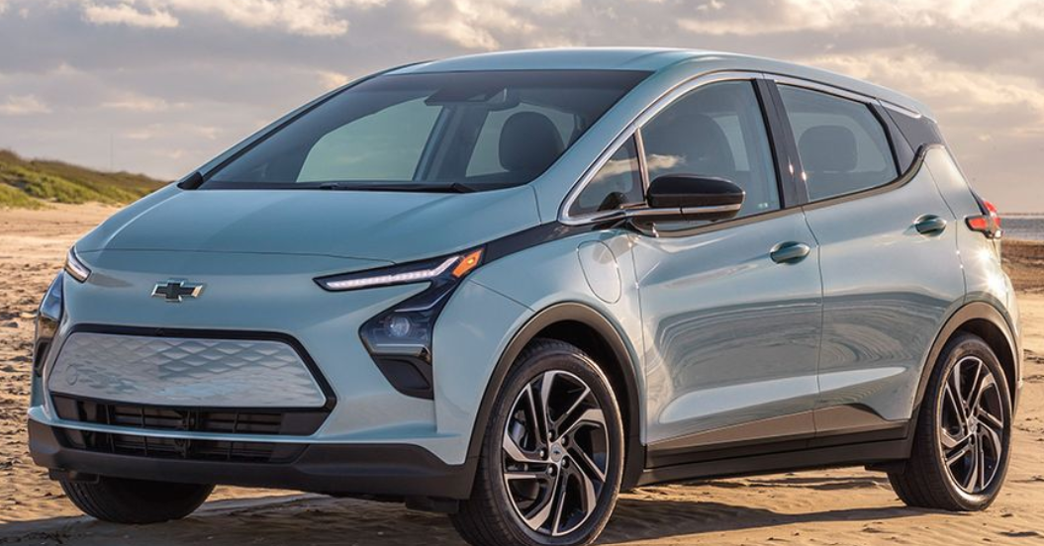
Facts About EVs
More affordable models are coming to market
Prices are not at parity but expected to in the coming few years (caveat: lots of variables here)
Total Cost of Ownership is often less the comparable gas cars
Depending on gas prices, financing and driving habits
Tax benefits from IRA
Used EV’s receive a $4,000 or 30% tax credit (whichever is less)
Most charging is done at home
More than 40% of MGE’s customers live in multifamily buildings with limited access to home charging

Slide 3
EV’s are Coming! Adoption Forecast
Federal goal of 50% of new car sales to be EV by 2030
Wisconsin's NEVI plan estimates 843,000 EVs in WI by 2040
Dane Co generally represents 25% of WI’s EVs so this would be about 210,000 EVs by 2040in Dane County by 2040

Slide 4
Local market- About 3,300 BEVs registered in Dane County since 2010

Slide 5
Barriers to EV adoption
Limited charging infrastructure
Range anxiety
Upfront costs
Awareness/Education
I can’t buy an EV until there is more charging available
There’s not enough charging available because no one drives EVs

Slide 6
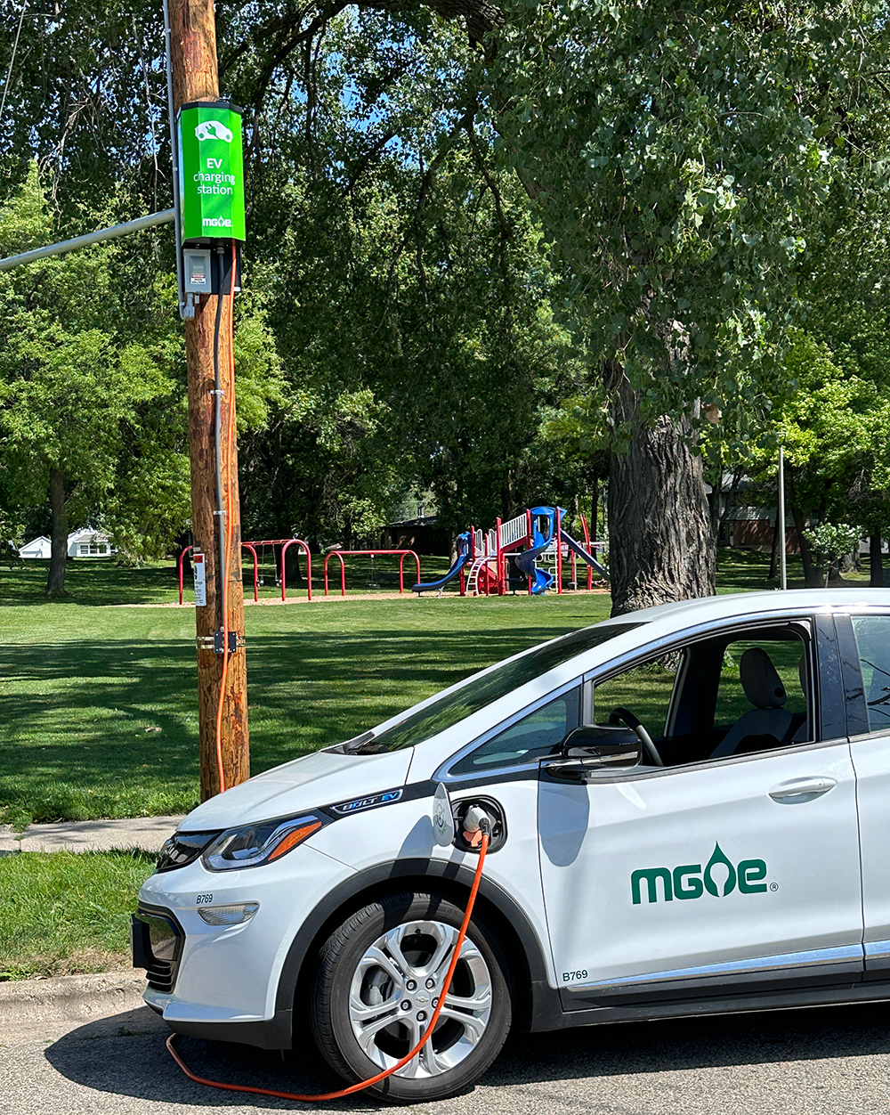
Pole Mounted Chargers
Accessibility and convenience
Utilizes existing infrastructure
Public visibility and awareness
Flexibility & Scalability

Slide 7
Technical Site Screening Criteria
Nearby Utility Infrastructure
Much of MGE’s system is underground
Near Free Amenities
where people can spend time but don’t feel obligated to spend money
Place where people can park for up to 4 hours (Minimum 2 hours)
Approx time for “full” charge is 4 hours
Average charging time for MGE’s chargers is 2 hours
Available parking
Justice 40
Align with Federal Inflation Reduction Act Requirements

Slide 8
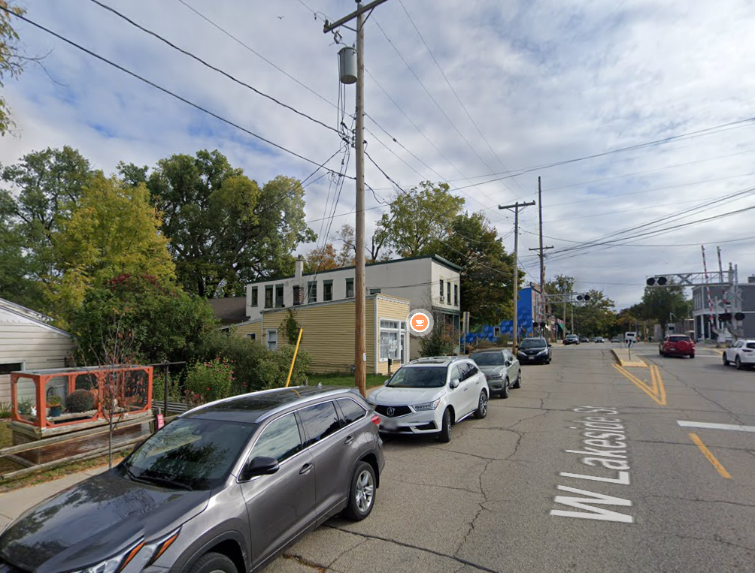
Lakeside St.
Mix of single family and multi-unit buildings nearby
School nearby
Evidence of EV ownership already
Ample parking
Amenities:
Many small businesses

Slide 9
We are seeking input and feedback
Community events
Stakeholder Meetings
Individual Feedback

Slide 10
Next Steps
Installation to happen in March/April
Ribbon cutting event on May 30th
Developing some communications materials (blog posts, social media content etc)

